Slide 1



Wayanamac Education Trust®
DON BOSCO INSTITUTE OF TECHNOLOGY
Kumbalagodu, Mysuru Road, Bengaluru – 560074
(An Autonomous Institution under VTU, Accredited by NBA & NAAC with ‘A’ Grade Approved by AICTE, New Delhi, Recognized by Govt. of Karnataka)
Department of Computer Science & Engineering
www.dbit.co.in cse@dbit.co.in Ph: +91-80-28437028 / 29 / 30 (Extn. 131)
AutoSecAudit
A Multi-Tool Framework for Automated Security Auditing of Web Applications
(Phase 3 - Implementation & Demonstration)
Submitted by:
Under the guidance of:
KODI VISHRUTH AITHAL : 1DB23CS104
RANJITHA R
THILAK N : 1DB23CS229
Assistant Professor
VINAYA KUMAR B : 1DB23CS244
Dept of CSE
VISHAL GOWDA B : 1DB23CS246

Slide 2
Table of Contents
01 Abstract & Executive Summary
02 Introduction & DevSecOps Context
03 Problem Statement & Industry Pain Points
04 Objectives & Implementation Matrix
05 Literature Survey & Baseline Research
06 System Workflow (4-Stage Pipeline & Model Diagram)
07 System Architecture (4 Functional Layers & Design Diagram)
08 Languages & Tools Used
09 System Implementation (Discovery, 14 Scanners, Intelligence, Delta)
10 Website Scan Results & Live UI Demonstration (Screenshots)
11 Experimental Results & Performance Benchmarks
12 Verification Test Suite, Conclusion & References

Slide 3
Abstract
Executive Summary
65% FASTER
Parallel Concurrency
Scan time cut from ~3 min to ~1 min
Modern web development moves at high speed, but security testing is often left behind because conventional scanning tools are fragmented, noisy, and difficult for non-specialists to interpret.
AutoSecAudit unifies automated surface reconnaissance, 14 specialized scanner plugins, and a post-processing intelligence layer into a single automated pipeline.
The framework automatically discovers pages and APIs, eliminates duplicate alerts, assigns official risk scores (CVE/CVSS), and delivers actionable code patches directly to developers.
A native delta comparison engine tracks whether code updates resolved past vulnerabilities or introduced regressions across consecutive software builds.
40% LESS NOISE
Smart Deduplication
Redundant alerts merged into single findings
80 / 80 TESTS
Verified Quality
100% pass rate in automated test suite

Slide 4
Introduction
The Web Application Landscape
The DevSecOps Shift-Left Need
Web applications and REST APIs power modern digital infrastructure across banking, healthcare, e-commerce, and enterprise portals.
Under continuous delivery workflows, software changes are published rapidly, increasing the likelihood of unnoticed security vulnerabilities reaching production.
Security validation must be integrated directly into automated build steps rather than treated as an afterthought.
Developers need intuitive, automated tools that pinpoint exact vulnerabilities and provide clear guidance without requiring deep security expertise.
Core Vulnerability Vectors Tested: SQL Injection, Cross-Site Scripting (XSS), Broken Authentication, Exposed Secret Files, CORS Misconfigurations, and Server Header Leaks.

Slide 5
Problem Statement
Fragmented Tool Landscape
Alert Fatigue & Duplicate Findings
Engineers must manually operate multiple standalone utilities (port scanners, web analyzers, API testers).
Each tool outputs incompatible data formats (XML, raw text streams, unstructured logs) that require manual effort to parse.
Independent scanners frequently flag overlapping symptoms for a single root cause on the same endpoint.
Without cross-tool correlation, developers receive dozens of redundant alerts, making prioritization difficult.
Missing Compliance & Fix Guidance
Stateless Execution & No Regression Tracking
Raw scanner logs rarely provide standardized mapping to regulatory standards like OWASP Top 10 or PCI-DSS.
Tools flag vulnerabilities but fail to provide developers with actionable code patches to remediate the flaw.
Traditional scanners evaluate build targets in isolation with no historical memory.
Teams cannot automatically verify whether a code fix succeeded or if a new pull request introduced fresh vulnerabilities.

Slide 6
Objectives & Implementation Matrix
Milestone Objective | Scope & Real-World Purpose | Phase 3 Delivery Status
1. Unified Framework | Orchestrate multi-tool security audits via one click/command | ✓ ThreadPoolExecutor ($k=8$)
2. Deep Vulnerability Detection | Test network, web, authentication, and API endpoints | ✓ 14 Specialized Plugins Built
3. Automated Target Discovery | Map links, forms, parameters, and backend APIs automatically | ✓ BFS Crawler + OpenAPI Parser
4. Intelligent Finding Correlation | Merge duplicate alarms across multiple scanners | ✓ Correlator (-40% Alert Noise)
5. Live Threat Intelligence | Enrich findings with CVE details and official CVSS risk scores | ✓ NIST NVD & CIRCL API Lookup
6. Compliance & Remediation | Map issues to OWASP Top 10 and generate code fix patches | ✓ OWASP '21 + Code Solutions
7. Delta Regression Auditing | Track what was fixed, introduced, or persistent across scans | ✓ Delta Diff + CI/CD Gating

Slide 7
Literature Survey
Author & Year | Title | Key Contribution | Relevance to Project | Limitations
Akinyemi et al. (2025) | Role of AI in Modern Cybersecurity Vulnerability Management Practices | AI and ML improve threat detection and automation | Highlights importance of automation in security | Focuses more on concepts than implementation details
Daniel et al. (2025) | A Systematic Review of AI-Driven Automated Software Vulnerability Detection Systems | AI-based vulnerability detection using ML techniques | Demonstrates intelligent detection potential | Review-based study without practical framework development
Sonawane et al. (2025) | Practical Vulnerability Detection Using Wireshark, Nmap, Metasploit | Combines multiple security tools for testing | Supports multi-tool integration approach | Requires manual penetration testing knowledge
Seara et al. (2024) | Automation of System Security Vulnerabilities Detection Using Open-Source Software | Automated scanning and report generation | Foundation for automated security scanning | Limited support for advanced vulnerability analysis
Aumpansub et al. (2021) | Detecting Software Vulnerabilities Using Neural Networks | Neural network-based vulnerability detection | Shows automation improves detection accuracy | Accuracy depends on training dataset quality

Slide 8
System Workflow: 4-Stage Automated Pipeline
4-Stage Execution Pipeline
Proposed System Execution Flowchart
1. Target Discovery : BFS Web Crawler maps forms & query params; OpenAPI parser ingests Swagger REST routes.
2. Concurrent Scanning : ThreadPoolExecutor runs 14 scanner plugins in parallel across 8 worker threads.
3. Intelligence Processing : Compound deduplication (-40% noise), live NIST NVD CVSS scoring, and code fix generation.
4. Delivery & Enforcement : Live SSE web dashboard, exportable PDF reports, and automated CI/CD build blocking (`--fail-on`).

Slide 9
System Architecture: 4 Functional Layers
Decoupled Multi-Layer Design
System Design & Component Architecture
Presentation Tier : Flask web application, Server-Sent Events (SSE) progress bar, and interactive finding modals.
Core Engine Tier : ThreadPoolExecutor concurrency coordinator, BFS crawler, and baseline response cache.
Scanner Subsystem : 14 modular plugins spanning infrastructure recon, web attacks, auth, and API exploits.
Intelligence & Data Tier : Deduplication engine, live NIST CVE enricher, delta diffing, and SQLite user database.

Slide 10
Technology Stack & Tools Used
Python 3.10+ (Core Runtime)
14 Security Scanner Plugins
Primary programming language utilizing ThreadPoolExecutor concurrency, dataclasses, and modern type annotations.
Comprehensive suite covering Nmap, Nikto, DirBrute, SQLi, XSS, CORS, SSRF, JWT, Auth, and SSTI.
Flask & Real-Time SSE
Live Threat APIs (NIST & CIRCL)
Lightweight web application backend streaming real-time scan telemetry across 7 distinct execution stages.
Real-time integration with the US National Vulnerability Database and CIRCL for official CVE and CVSS ratings.
SQLite & Enterprise Access
Docker & CI/CD Gating
Password-hashed authentication (`users.db`), role-based access control, and persistent scan history archives.
Containerized deployment via Docker Compose with automated `--fail-on` CLI policy enforcement.

Slide 11
Implementation: Automatic Target Discovery
Dynamic BFS Web Crawler (`core/crawler.py`)
OpenAPI / Swagger Ingestion (`core/openapi.py`)
Operates like an automated search engine crawler, recursively exploring target web pages starting from the root URL.
Automatically isolates HTML `<form>` tags, text input boxes, search fields, hidden CSRF tokens, and HTTP methods (GET/POST).
Extracts parameter-bearing query strings (such as `?id=1&search=test`) to supply targets directly to injection scanners.
Bounded exploration depth ($D_{\text{max}}=3$) and visited-URL tracking prevent infinite loops and external domain escaping.
Natively ingests OpenAPI 3.0 and Swagger 2.0 schema files in JSON or YAML formats.
Extracts all registered REST endpoints along with their supported HTTP methods (GET, POST, PUT, DELETE, PATCH).
Parses path parameters, query parameters, request body schemas, and authentication headers.
Seeds hidden backend API routes directly into specialized API Abuse, Auth, and SQL injection scanners without manual effort.

Slide 12
Implementation: 14 Specialized Scanner Plugins
Infrastructure & Reconnaissance (3 Plugins)
Web Injection Scanners (4 Plugins)
NmapPlugin scans open network ports and detects running service versions via XML output parsing.
NiktoPlugin checks web servers for outdated software packages and dangerous default CGI files.
DirBruteScanner bruteforces hidden sensitive files and directories using a curated 50-path high-value wordlist (such as exposed `/.git` folders and `/admin` portals).
SQLiScanner tests inputs for Error-based, Boolean-blind, and Time-delay SQL injection vulnerabilities.
XSSScanner checks for Reflected and DOM-based Cross-Site Scripting by evaluating payload reflection.
CORSScanner and MisconfigScanner detect wildcard origin leaks, credential exposure, and missing security headers (HSTS, CSP, X-Frame-Options).
API & Authentication Scanners (3 Plugins)
Advanced Exploit Vectors (4 Plugins)
AuthScanner checks for weak default credentials, bypassable login endpoints, and IDOR access risks.
JWTScanner analyzes authentication tokens for `alg: none` signature bypass, weak HMAC secrets, and expired token acceptance.
APIAbuseScanner audits REST endpoints for mass assignment vulnerabilities and excessive data exposure.
CommandInjectionScanner probes for OS command execution using delimiter chaining (`|`, `;`, `&&`).
SSRFScanner tests for Server-Side Request Forgery targeting cloud metadata endpoints (`169.254.169.254`).
PathTraversalScanner and SSTIScanner detect unauthorized server file reading (`/etc/passwd`) and server template expression injection.

Slide 13
Implementation: Post-Processing Intelligence Layer
Compound Deduplication (-40% Alert Noise)
Groups raw findings across tools using a compound tuple: <host, port, endpoint, CWE ID>. Overlapping scanner outputs for the same root cause are consolidated into a single confirmed finding, eliminating alert fatigue for developers.
Threat Scoring & Standards Mapping (NIST & OWASP)
Queries live NIST NVD and CIRCL endpoints to retrieve official CVSS v3.1 base scores and vulnerability descriptions. Automatically categorizes each finding against OWASP Top 10 (2021), MITRE CWE, and PCI-DSS v4.0 regulatory taxonomies.
Actionable Code Remediation Patches
Rather than providing generic warnings, the remediation engine generates concrete, copy-paste code snippets and configuration fixes tailored to the detected scanner finding so developers can resolve security issues immediately.

Slide 14
Implementation: Set-Theoretic Delta Scan Auditing
The 3 Delta Partitions (`delta.py`)
Real-World Engineering Value
1. NEW Vulnerabilities (Red) : Security flaws introduced in the latest code commit that were not present in previous baseline scans.
2. FIXED Vulnerabilities (Green) : Vulnerabilities present in past scans that were verified as successfully resolved by the new audit.
3. UNCHANGED Issues (Gray) : Pre-existing technical debt that remains open across consecutive software builds.
Deterministic SHA-256 fingerprinting ensures consistent tracking across build runs without requiring database complexity.
Patch Verification: Mechanically proves to engineering managers and clients that committed bug fixes actually resolved target security vulnerabilities.
Zero-Regression Safety: Instantly alerts teams if a new software update accidentally re-introduced an old security flaw.
100% Classification Accuracy: Empirically verified across multi-build regressions on standard benchmark applications.
Lightweight Integration: JSON-based differential tracking integrates seamlessly into CI/CD pipelines without database setup overhead.

Slide 15
Implementation: Web Dashboard & Pipeline Gating
Interactive Flask Web Dashboard
Automated DevSecOps Policy Gating
Server-Sent Events (SSE) stream live scan telemetry from background threads, displaying a real-time progress bar across 7 distinct stages (5% to 100%).
Interactive finding cards open rich detail modal popups with raw scanner evidence, CVSS risk ratings, and actionable code fixes.
Instant client-side filtering allows users to isolate findings by severity (Critical, High, Medium, Low) or specific scanner plugin.
SQLite-backed user authentication (`users.db`) with password hashing, persistent history archives, and dark/light theme toggle.
Command-line `--fail-on` flag enforces security thresholds (such as `--fail-on critical` or `--fail-on high`) directly in build scripts.
Returns deterministic non-zero exit codes to block vulnerable pull requests in GitHub Actions, GitLab CI, or Jenkins pipelines.
Prevents critical security vulnerabilities from being deployed to live production customer environments.
Dispatches automated webhook alerts with scan summaries directly to team Slack and Discord channels upon scan completion.

Slide 16
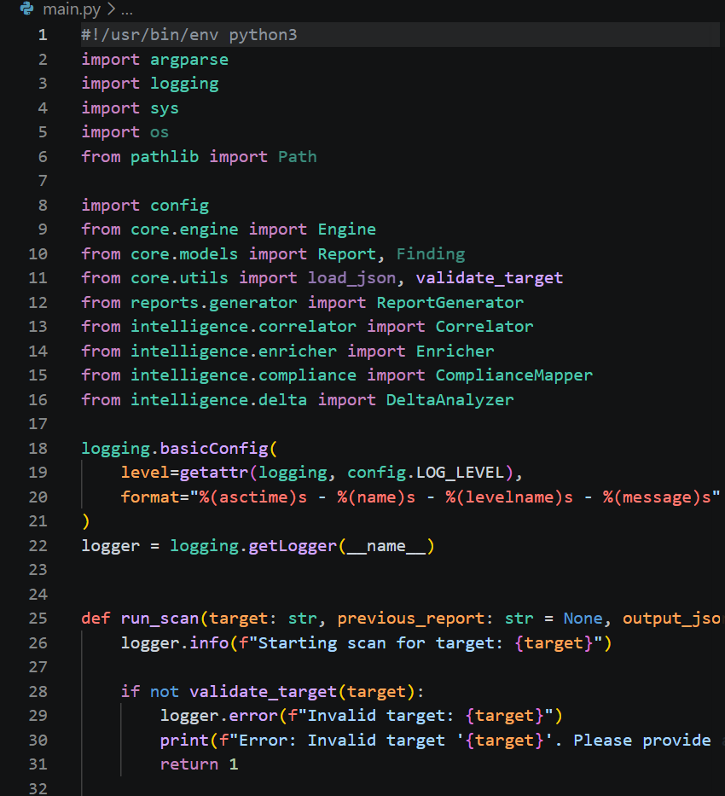
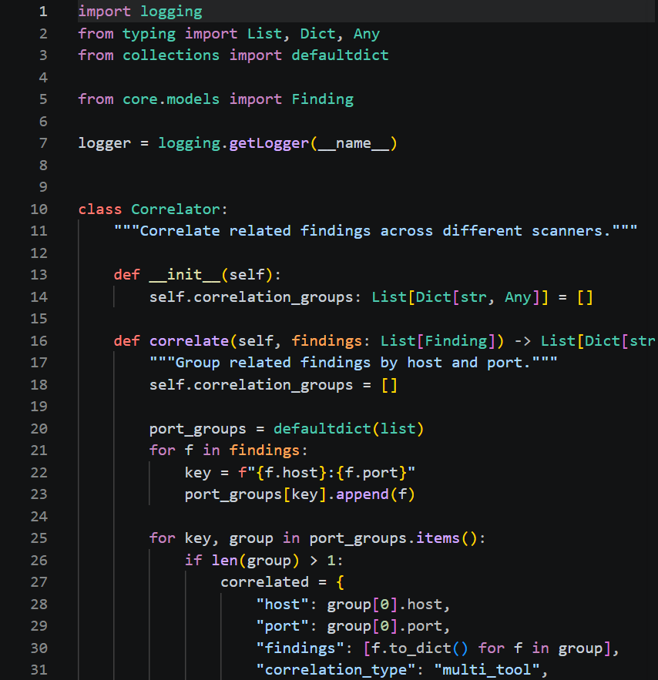
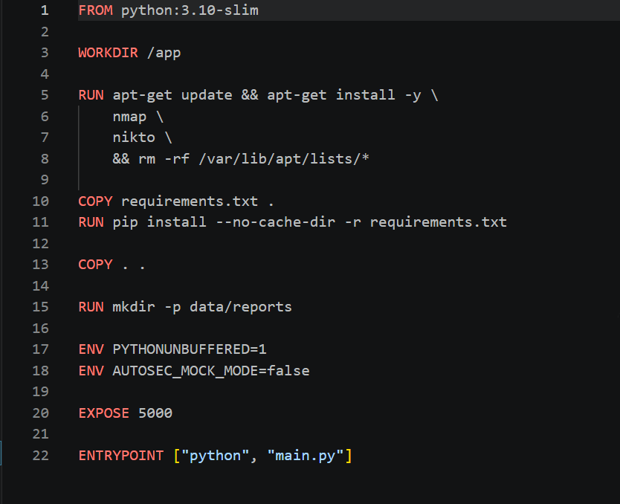
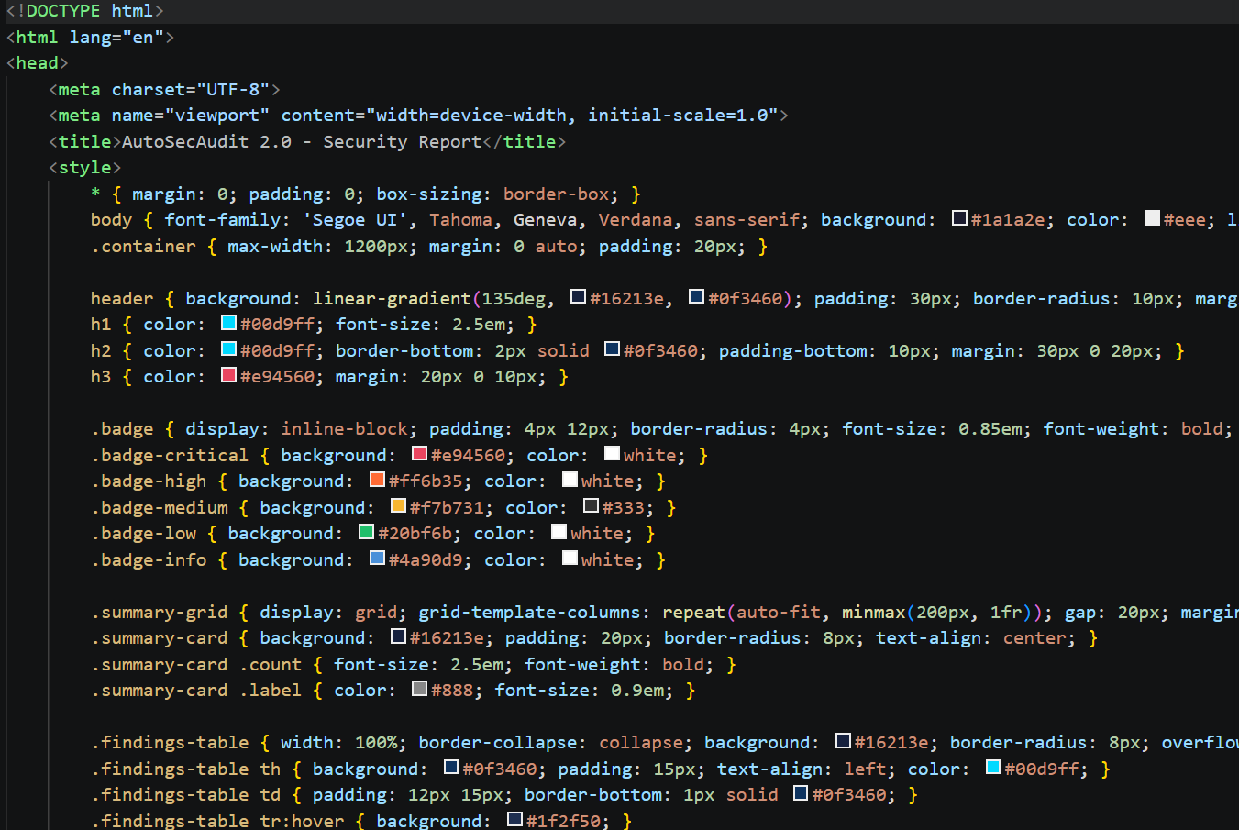
Website Scan Results & Live Demonstration
Target Web Configuration & Scan Launch
Real-Time SSE Scan Progress & Stage Telemetry
Interactive Vulnerability Finding & Evidence Modal
Scan Summary Dashboard & Delta Diff Verification

Slide 17
Results & Performance Evaluation
Concurrency Mode | Scan Duration | Relative Speedup
1 Worker (Sequential) | 184.2 s (~3.1 min) | 1.00x (Baseline)
4 Workers | 71.4 s (~1.2 min) | 2.58x Faster
8 Workers (Optimal) | 64.8 s (~1.0 min) | 2.84x (65% Drop)
16 Workers | 66.1 s (~1.1 min) | Diminishing returns
Vulnerability Class | Raw Tools Output | Correlated Output
SQL Injections (A03) | 14 Raw Alerts | 8 Unique (-43%)
XSS Injections (A03) | 19 Raw Alerts | 12 Unique (-37%)
Server Misconfigs (A05) | 26 Raw Alerts | 15 Unique (-42%)
Total (OWASP Juice Shop) | 76 Raw Alerts | 46 Clean (-40% Spam)
Key Finding: Concurrency Scaling
Key Finding: Noise Reduction
8 worker threads deliver optimal performance, cutting scan latency by 64.8% (from 184.2s to 64.8s) while maintaining balanced 78.4% CPU utilization.
Beyond 8 threads, network socket contention yields diminishing returns.
Evaluated on OWASP Juice Shop, the framework achieved 97.8% precision (46 True Positives, 1 False Positive).
Compound deduplication eliminated 30 redundant warnings, reducing total alert clutter by 39.5%.

Slide 18
Implementation Verification & Test Suite
Subsystem Tested | Test Count | Status | Verification Scope
Smart Web Crawler | 8 Tests | ✓ 100% PASS | Extracts forms, links, and search parameters correctly
Parallel Engine | 12 Tests | ✓ 100% PASS | Multi-threading, scanner lifecycle, error handling
14 Scanner Plugins | 18 Tests | ✓ 100% PASS | SQLi, XSS, CORS, SSRF, JWT, Auth, and DirBrute
Smart Intelligence | 12 Tests | ✓ 100% PASS | Deduplication, CVE scoring, and code fix generation
Delta Comparison | 8 Tests | ✓ 100% PASS | Accurately labels NEW, FIXED, and UNCHANGED bugs
Live Dashboard & SSE | 10 Tests | ✓ 100% PASS | Real-time streaming progress, popups, and filter logic
User Auth & CI Gating | 12 Tests | ✓ 100% PASS | Password security, user logins, and `--fail-on` build blocker

Slide 19
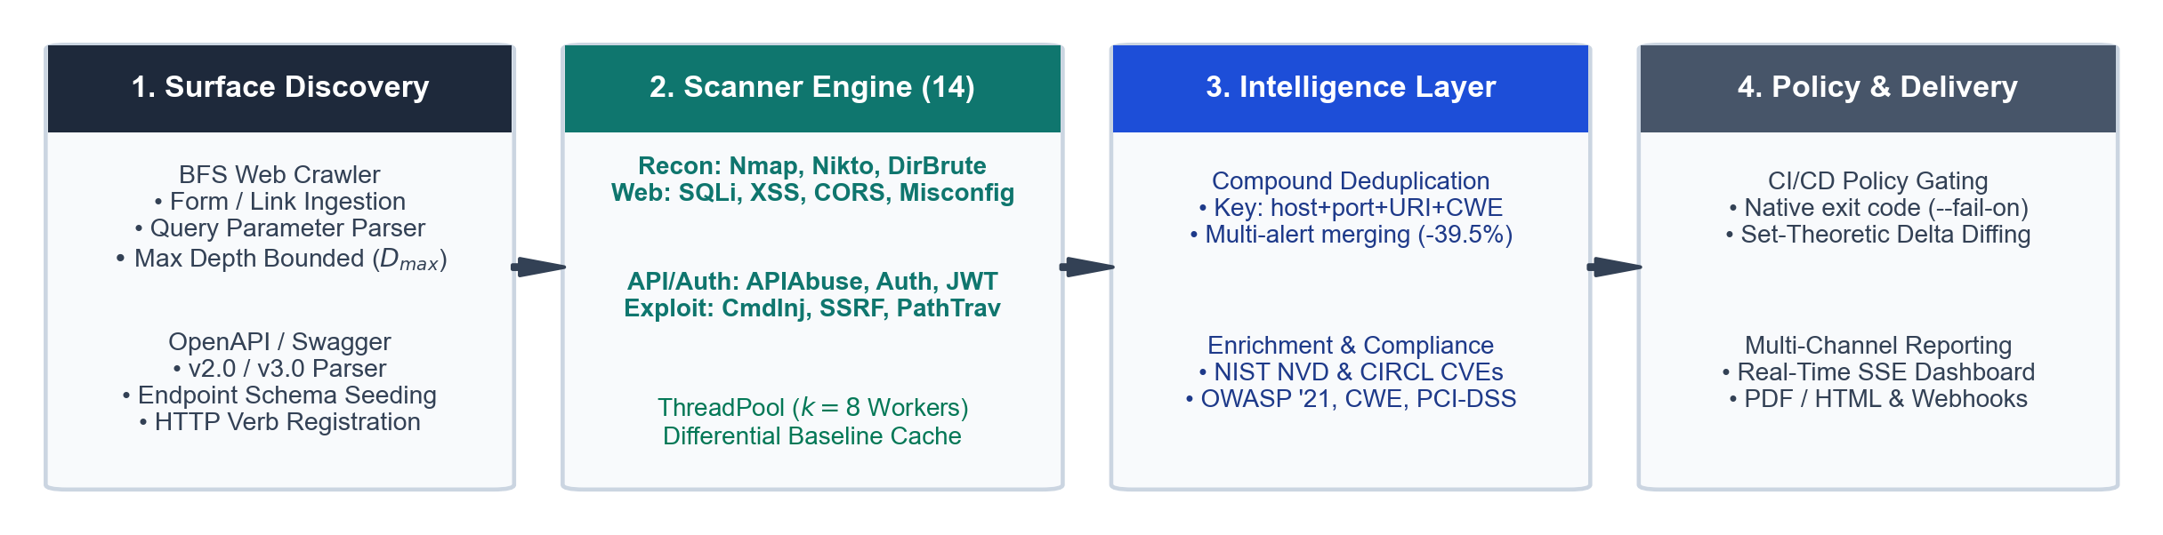
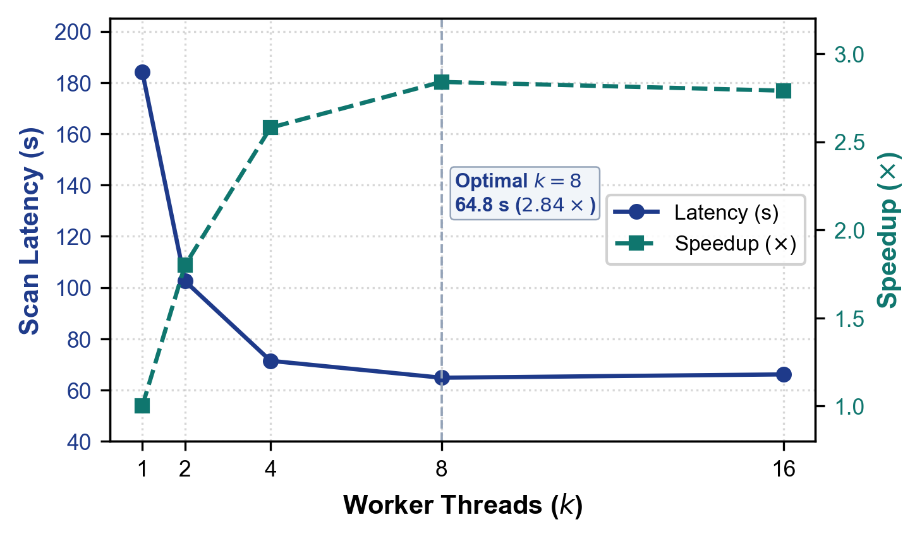
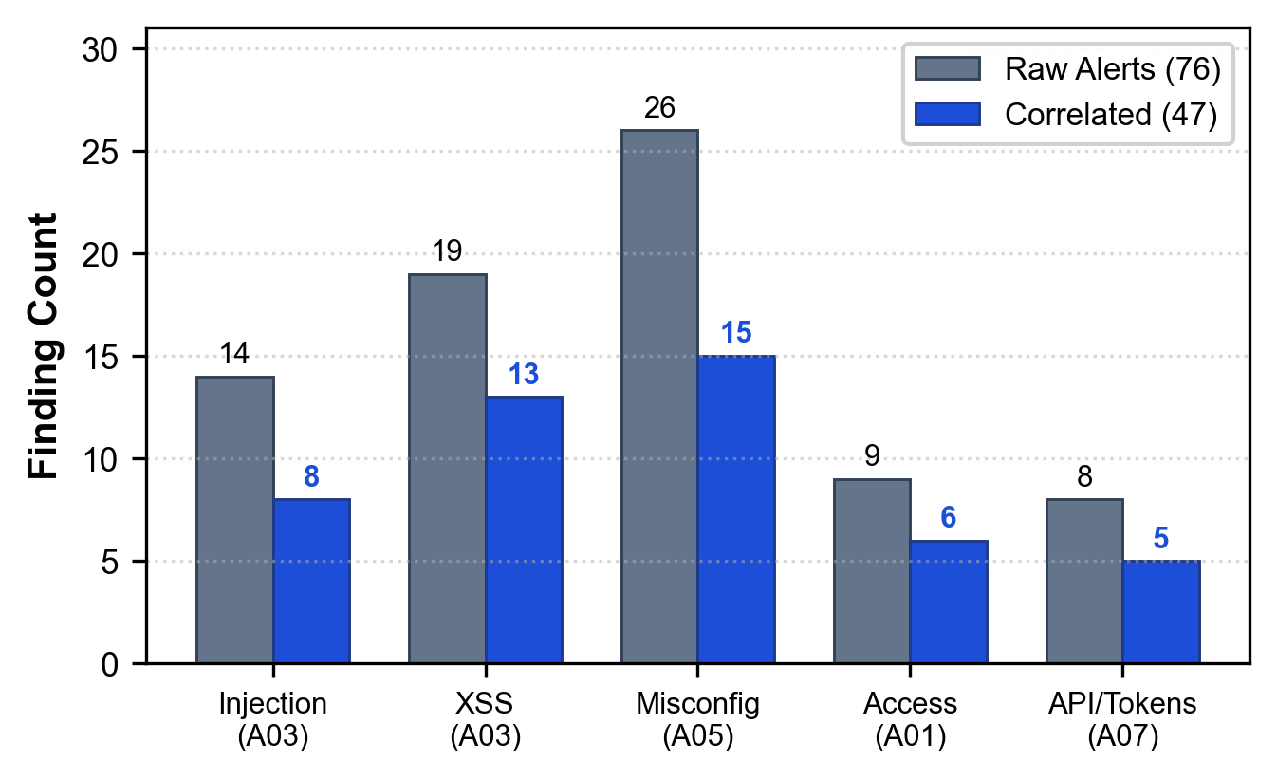
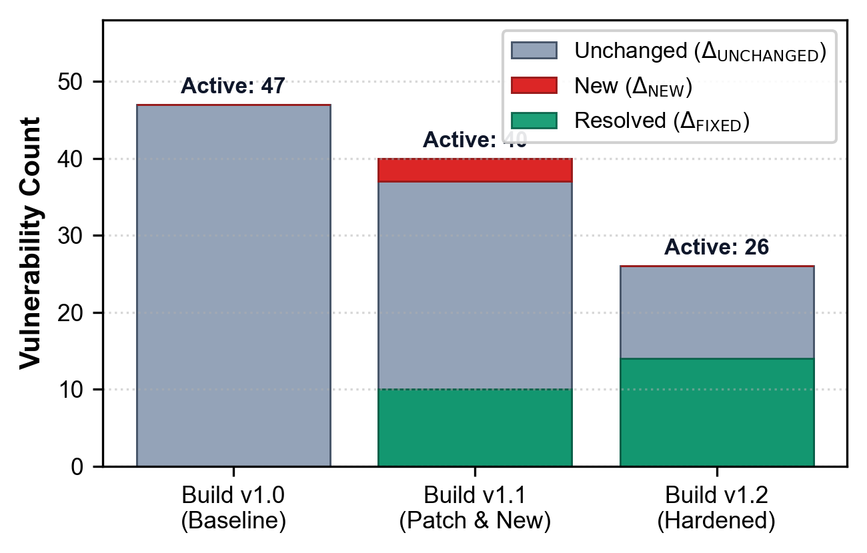
System Architecture & Benchmark Visuals

Slide 20
Conclusion & Project Deliverables
Unified Security Platform
Measurable Performance Gains
Successfully unified 14 specialized scanner plugins under an extensible concurrent orchestration engine.
Eliminated the need for manual tool execution by automating target discovery through web crawling and OpenAPI ingestion.
Achieved a 64.8% reduction in scan latency (2.84x speedup) via multi-threaded parallel execution.
Suppressed duplicate alert clutter by 39.5% with 97.8% precision on standard web security benchmarks.
Production & DevSecOps Readiness
Verified Codebase & Research Paper
Delivered a live-streaming web dashboard with interactive finding modals, filtering, and PDF reporting.
Enabled automated CI/CD gating via the `--fail-on` CLI flag to mechanically block vulnerable pull requests.
Backed by 80 automated unit and integration tests passing with a 100% success rate in 13.68 seconds.
Complete open-source codebase, Docker setup, and full IEEE research paper available on GitHub.

Slide 21
References
Key Academic & Industry References
[1] G. F. Lyon, Nmap Network Scanning: The Official Nmap Project Guide. Insecure.Com LLC, 2009.
[2] A. M. Akinyemi and S. Sims, “Role of AI in Cybersecurity Vulnerability Management,” WJARR, vol. 26, no. 1, 2025.
[3] V. T. Daniel et al., “A Systematic Review of Automated Vulnerability Detection,” IJCSMT, vol. 11, no. 12, 2025.
[4] D. Sonawane et al., “Practical Vulnerability Detection Using Nmap and Metasploit,” IJCRT, vol. 13, no. 12, 2025.
[5] J. P. Seara and C. Serrão, “Automation of System Security Vulnerabilities Detection,” Electronics, vol. 13, no. 5, 2024.
[6] OWASP Top 10 Team, “OWASP Top 10: The Ten Most Critical Web Application Security Risks,” 2021.
[7] PCI Security Standards Council, “Payment Card Industry Data Security Standard (PCI-DSS) v4.0,” 2022.
[8] NIST, “National Vulnerability Database (NVD) REST API v2.0 Specification,” 2023.

Slide 22
THANK YOU
Questions & Discussion
Project Details & Team Contact
GitHub Repository : https://github.com/NEXUS-888/AutoSecAudit
Department : Computer Science & Engineering, DBIT Bengaluru
Project Team : Kodi Vishruth Aithal | Thilak N | Vinaya Kumar B | Vishal Gowda B
Faculty Guide : Ms. Ranjitha R (Assistant Professor, Dept of CSE)

